Slide 1
Vaccines for COVID-19
What they are and how they work

Slide 4
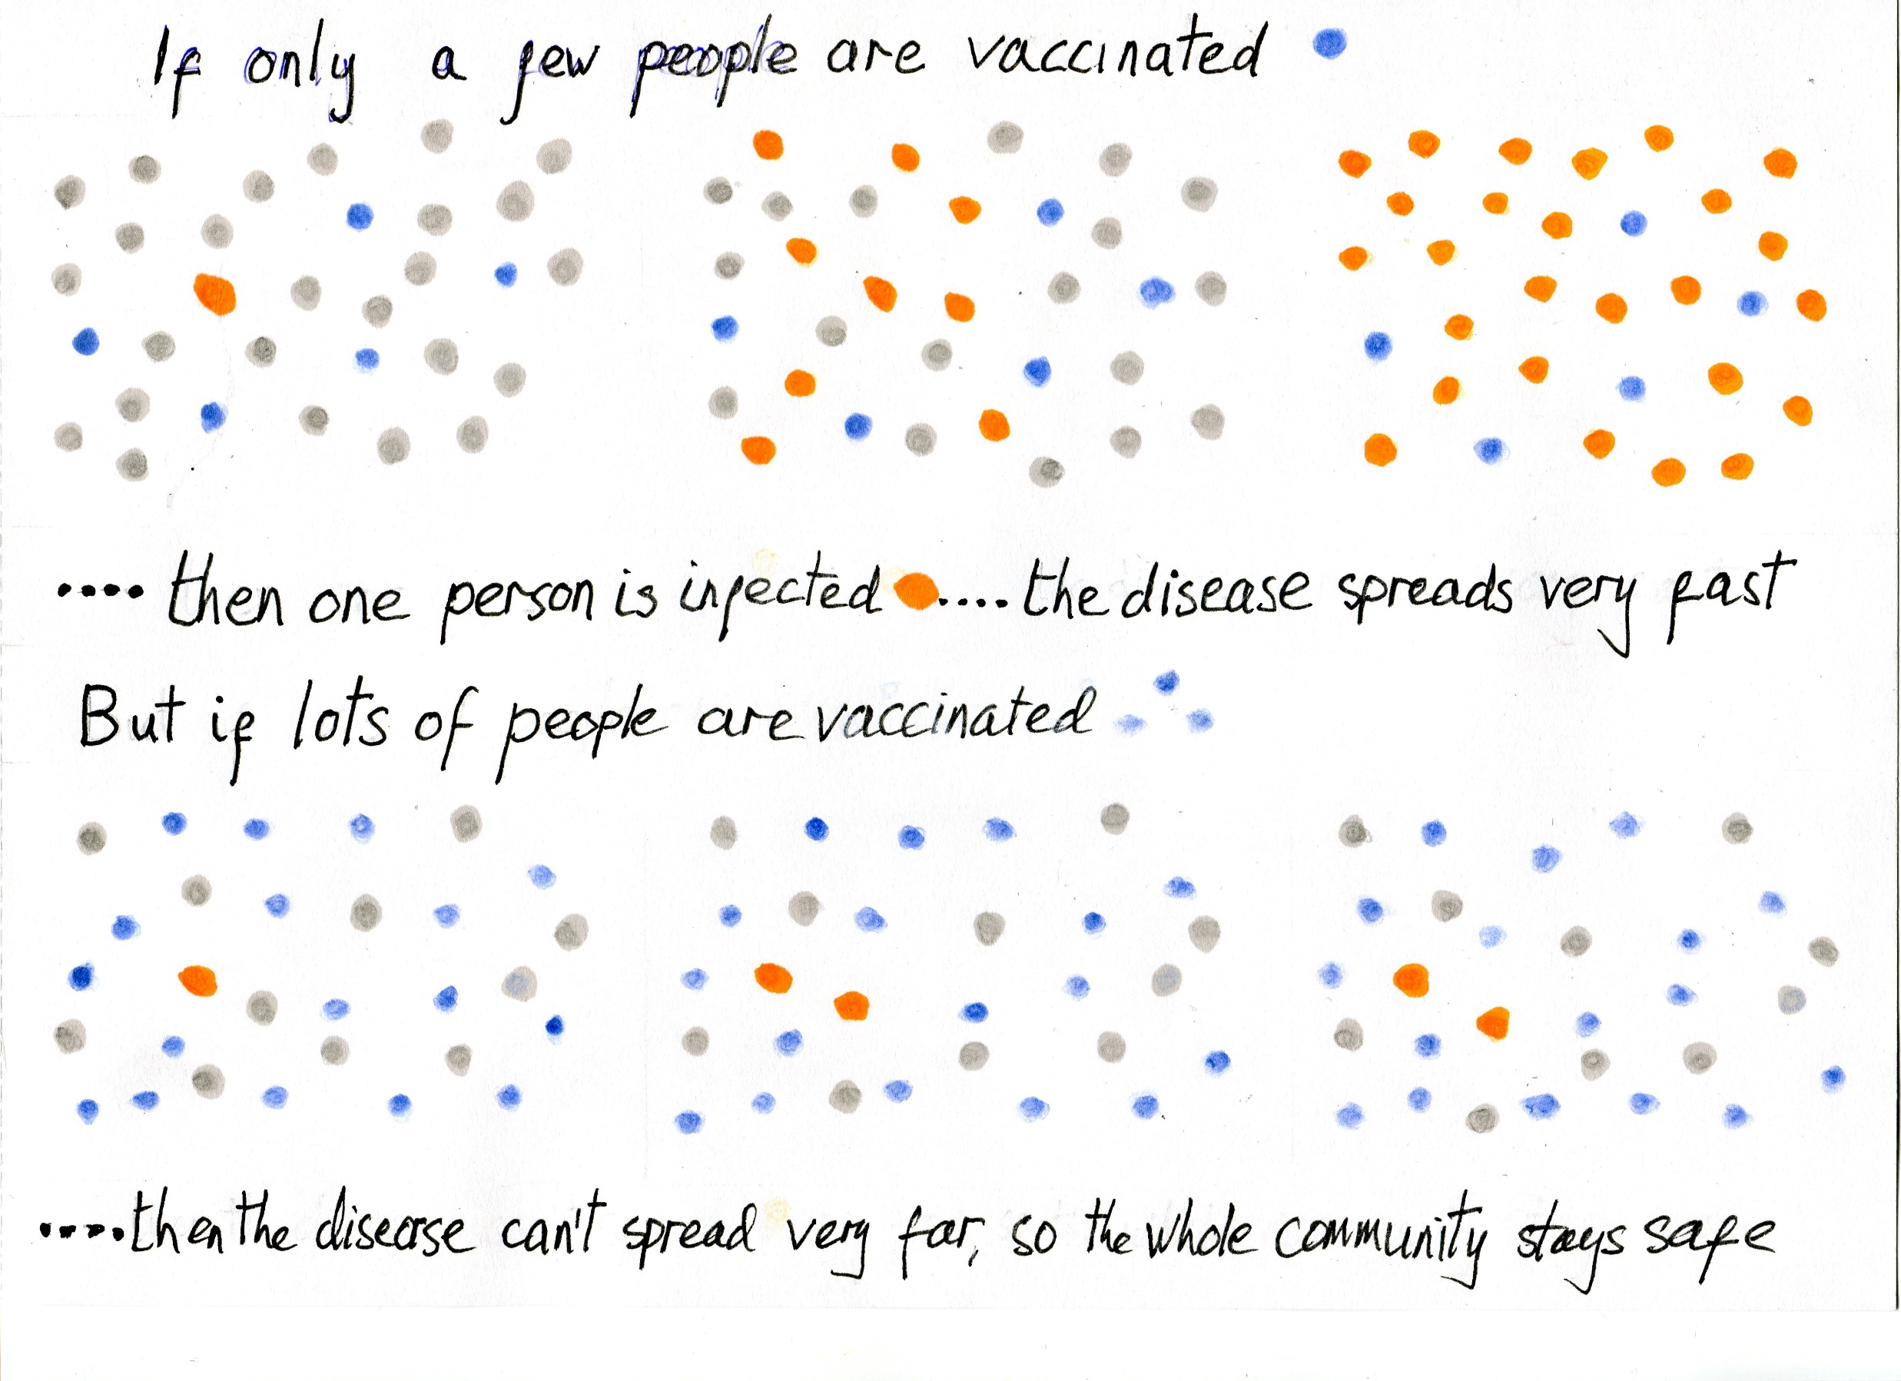

Slide 5
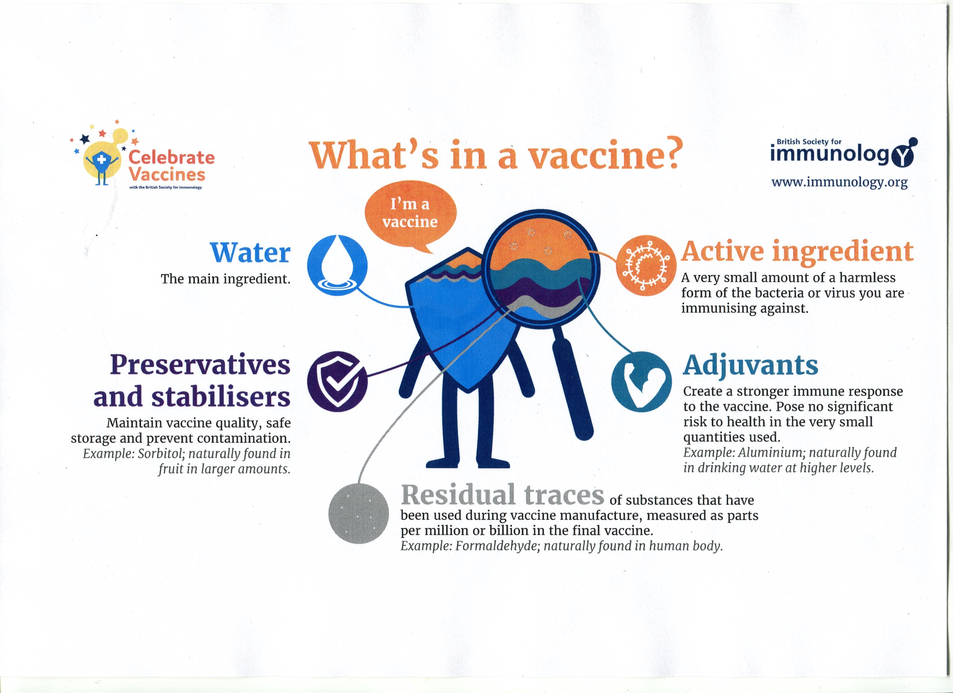

Slide 6
Viral Vector Vaccines
An unrelated, harmless virus, is modified to deliver SARS-CoV-2 genetic material.
Our cells use the genetic material to make a specific SARS-CoV-2 protein, which is recognised by the immune system to trigger a response.
The response builds immune memory, so your body can fight off SARS-CoV-2 in future.

Slide 8
Prioritisation for COVID-19 Vaccination
Residents in care homes for older adults and staff working in these homes
All those 80 years of age and over and frontline health and social care workers
All those 75 years of age and over
All those 70 years of age and over and clinically extremely vulnerable individuals
All those 65 years of age and over
Adults aged 16-65 years in an at-risk group
All those 60 years of age and over
All those 55 years of age and over
All those 50 years of age and over
Rest of the population (to be determined)

