Slide 1
Patient / service user conversation
[add in details about your event]

Slide 2
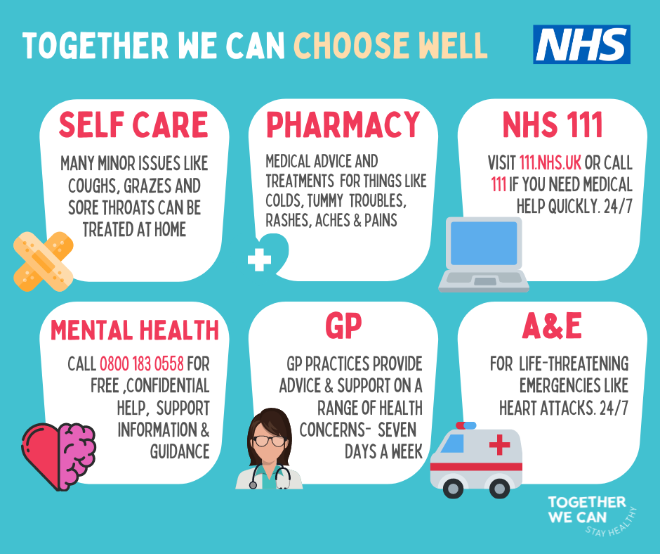
Campaign overview
Working with health and care partners, the CCGs in Calderdale and Kirklees have developed a communications campaign to signpost people to the right health service for their needs.
It will run from Summer 2021 through to the winter period 2021/22.

Slide 3
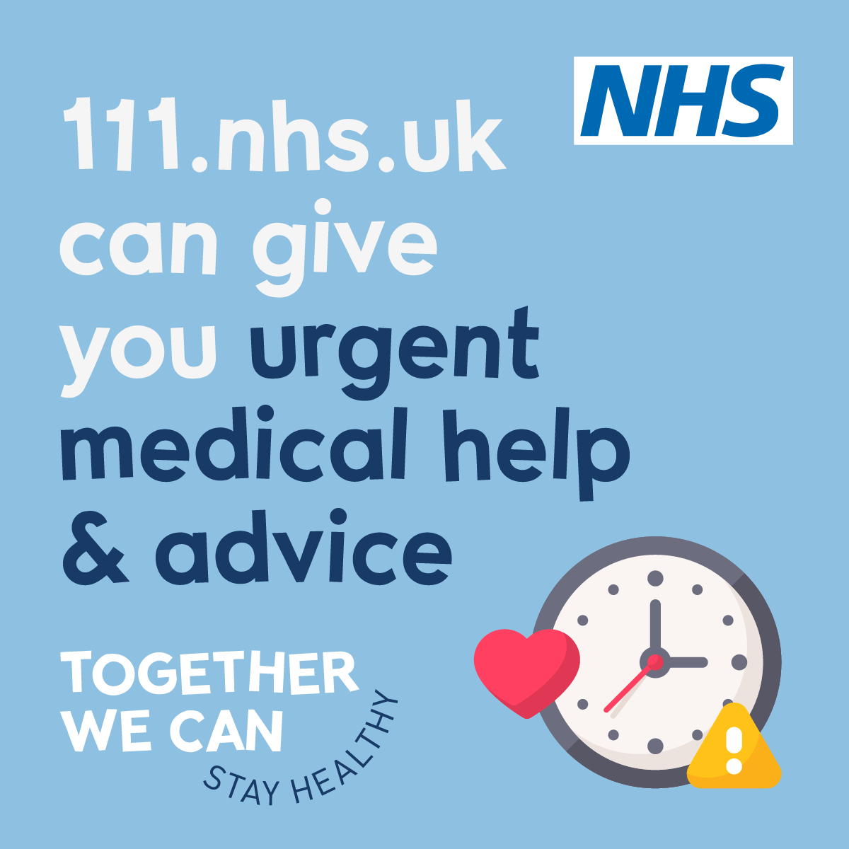
Key elements of the campaign
A dedicated website
Social media posts
News articles
Advertising
Printed leaflets and posters

Slide 4
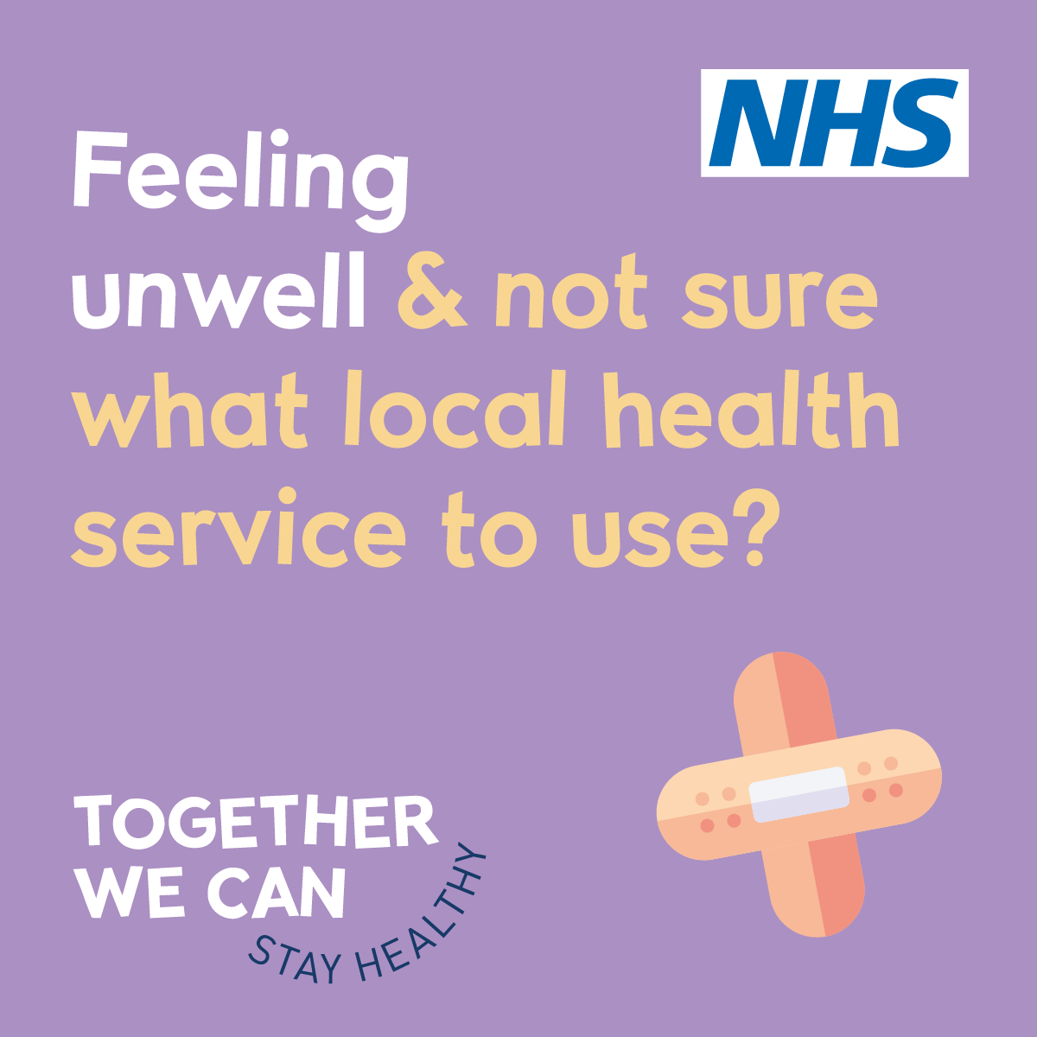
Patient involvement
The campaign has been informed by local people. You told us:
the first place you would go when feeling unwell was a pharmacy or doctor’s – unless it was an emergency
not everyone was aware of the NHS 111 service
you know it’s important to stay well and look after yourself eg via exercise and a good diet
it would be very helpful to have community and service information in one place
you welcomed the idea of wellbeing tips and self care ideas
very simple messaging, consistently delivered was the best way to engage

Slide 5
How can you help?
How can you help local people find the help and advice they need?
Encourage your practice / service to share messages on social media.
Spread the message by following, liking or sharing Tweets and Facebook posts from your practice or service.
Make sure leaflets and posters are available in public waiting areas.
Include information about the campaign in your patient newsletter.

Slide 6
Over to you – Quick Quiz
1. What service should you use …
for a sore throat or grazed knee?
if your child has a temperature?
when you need advice about treating diarrhoea?
if your symptoms have lasted for a couple of weeks and they won’t go away?
2. When should you visit A&E?
3. If you need urgent help but don’t know what service to use, what could you do?
4. Where can you get help when your GP practice is closed?

Slide 7
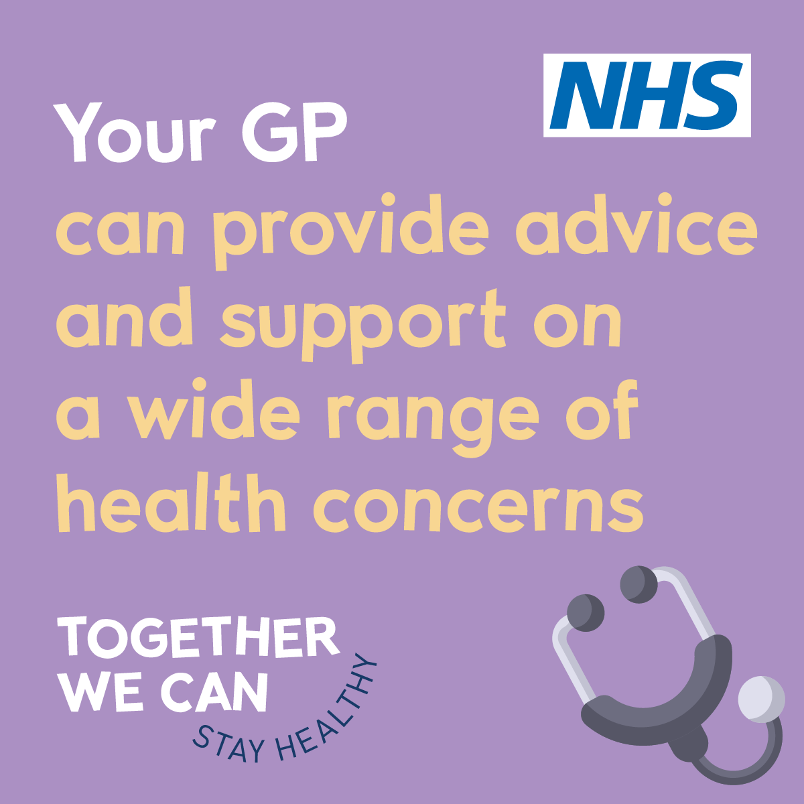
Over to you – 10 minute discussions
When they need help quickly, people do not always choose the right NHS service. Why do you think this might be? [10 minutes]
What else can the NHS do to help people find the right service for their needs? [10 minutes]

Slide 8
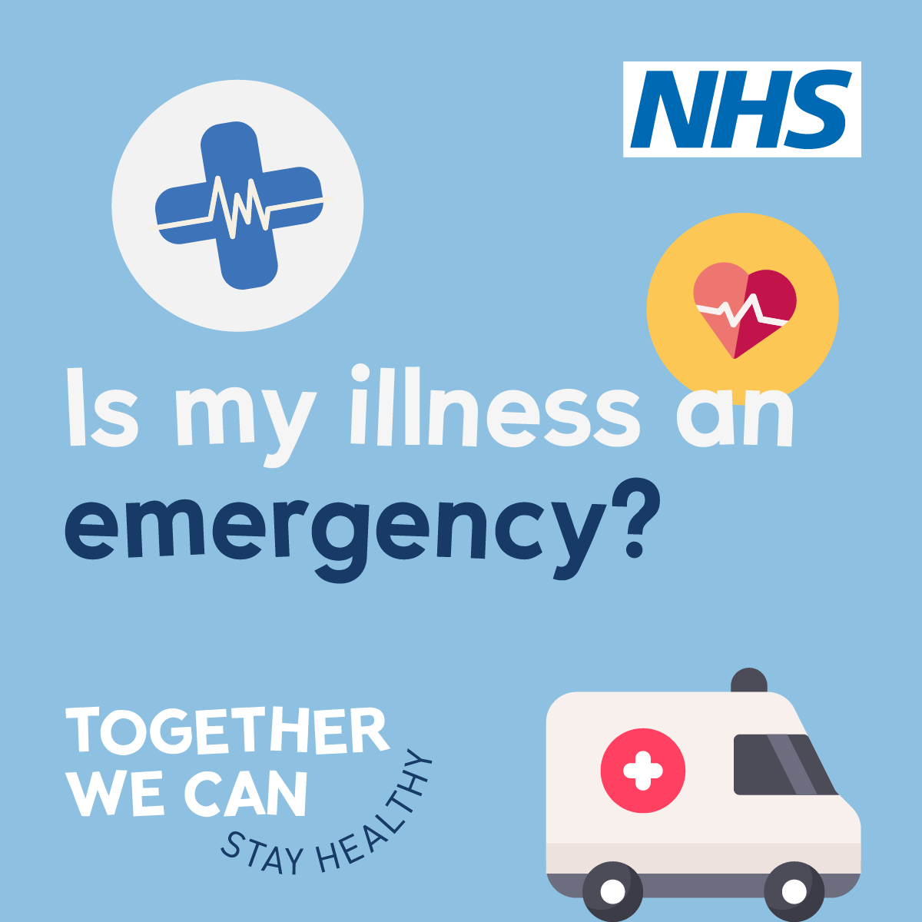
Over to you – 10 minute discussions
How could you help people in your practice / service to choose the right NHS service for their needs? [10 minutes]
Pick the 3 most popular suggestions and agree how you are going to make them happen. [10 minutes]

Slide 9
Find out more
By working together, we can all choose the right NHS service for our needs.
For information and advice about health services in Kirklees and Calderdale, please visit our website at www.Togetherwe-can.com

